Slide 1
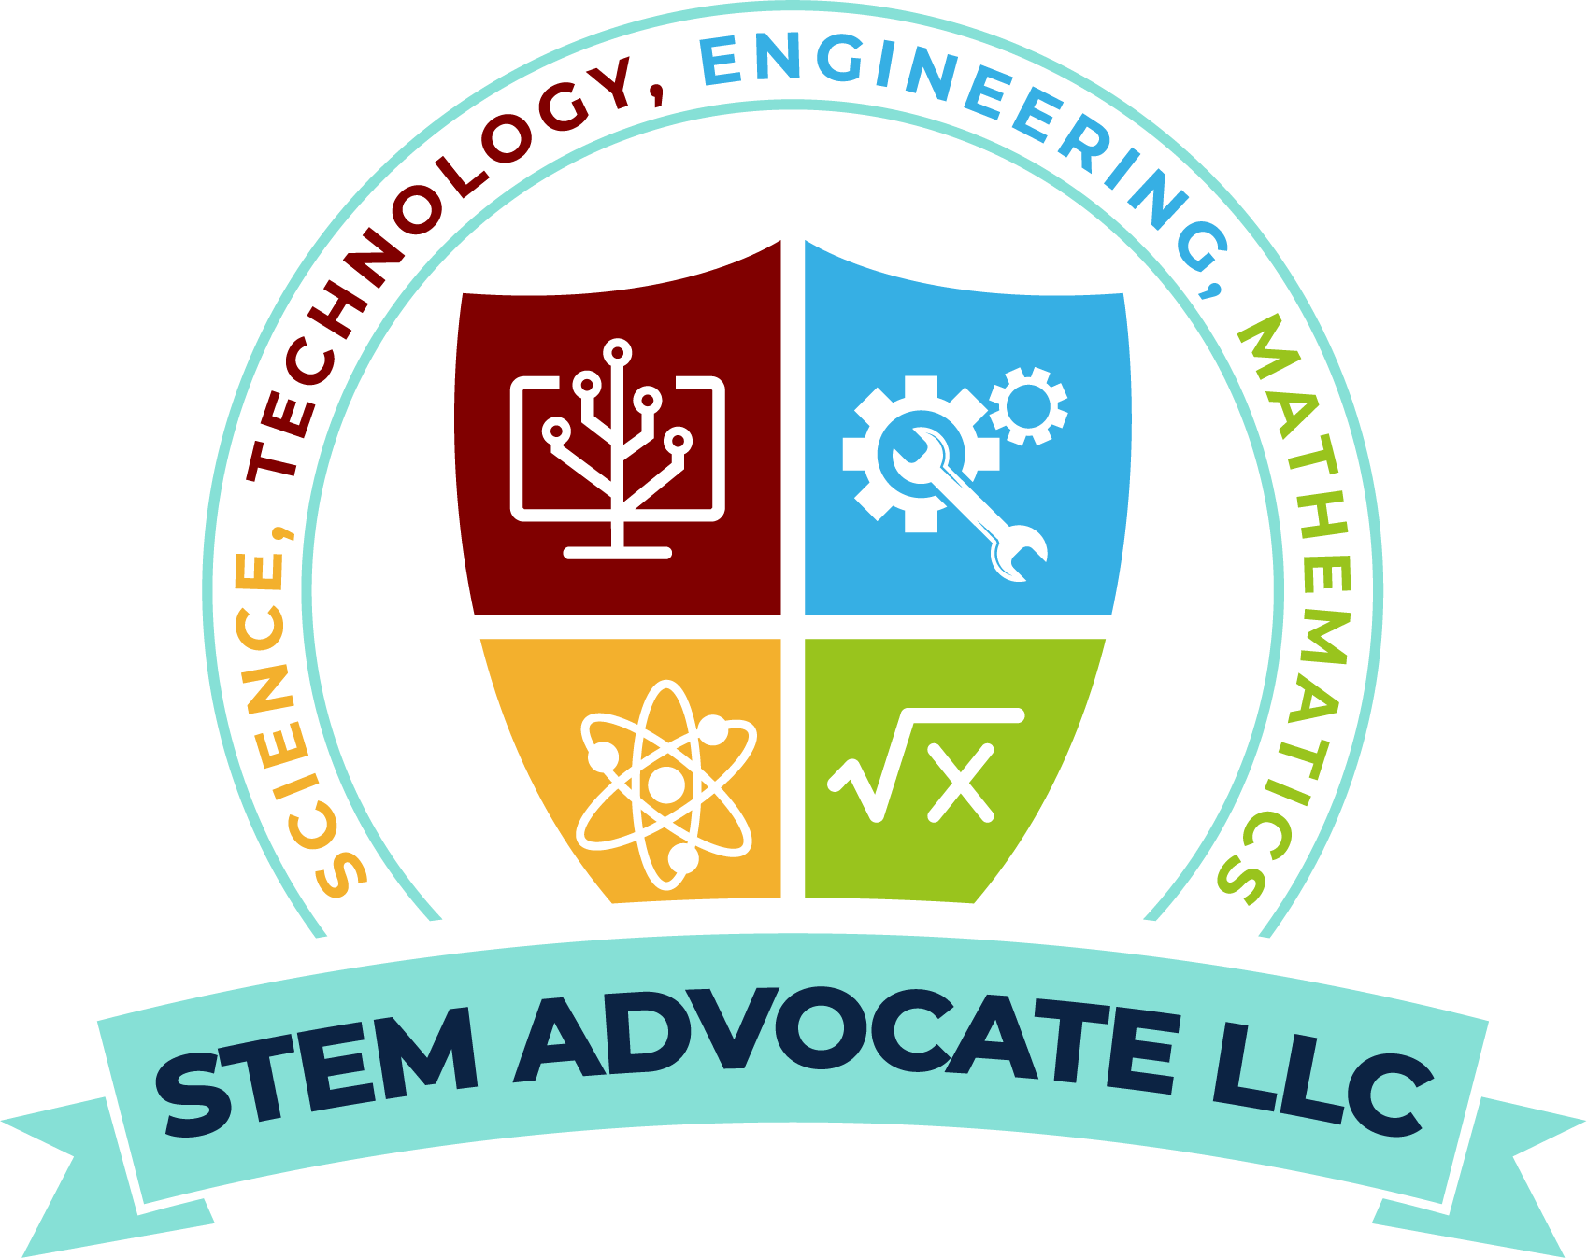
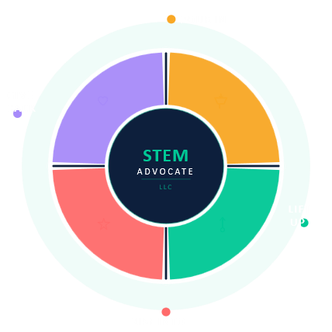




Investing in People. Transforming Communities.
STEM ADVOCATE LLC
Circular Economy – Hybrid Business Model
DEFINE, PLAN, and START YOUR STEM CAREER DEBT-FREE with support of PROFESSIONAL STEM MENTORS!
FUNDERS
STEM ADVOCATE LLC
Schools, Upward Bounds, Individuals, Foundations, Corporations, Government Partners who Pour In resources, grants, donations, & investments to fuel the mission.
The catalyst — programs, services, mentorship & pathways that Lift Up underrepresented STEM talent from opportunity gaps.
STUDENTS
COMMUNITIES
Young leaders who Rise Into careers, higher education, entrepreneurship, & innovation — becoming the next generation of STEM changemakers.
Alumni, families, & local ecosystems who Give Back — mentoring, hiring & reinvesting to keep the cycle thriving.
“Every dollar invested pours into a cycle that lifts students, transforms communities, and returns value for generations.”
— STEM ADVOCATE LLC | stemadvocatellc.com

